Slide 1


Pizza Sales Project
This project analyzes pizza sales data to gain insights into customer preferences, sales trends, and opportunities for optimization.
by Bhaskar Singh

Slide 2


Exploratory Data Analysis
1
Sales Volume
We examine the overall sales volume to understand the popularity of different pizza types, sizes, and toppings.
2
Order Frequency
We explore patterns in customer order frequency, such as peak hours, days of the week, and seasonal variations.
3
Sales Trends
We investigate trends in sales over time to identify growth opportunities and potential challenges.

Slide 3

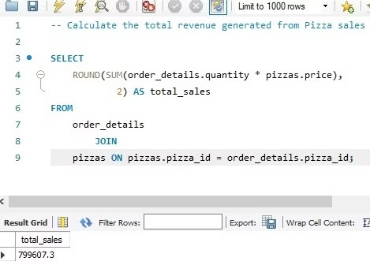
Pizza Sales Analysis
Overall Revenue

Slide 4

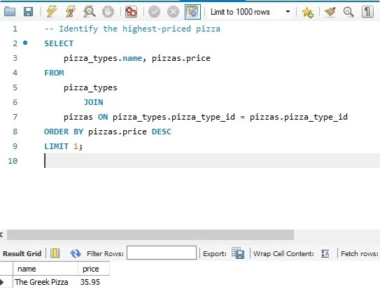
Pizza Sales Analysis
Highest priced Pizza

Slide 5

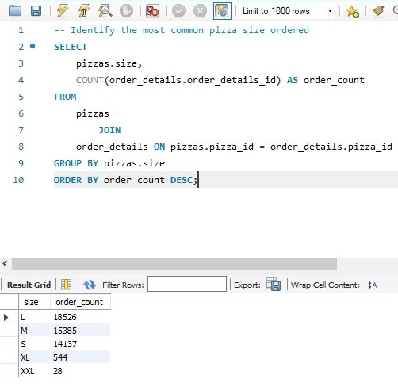
Pizza Sales Analysis
Most Common pizza size ordered

Slide 6

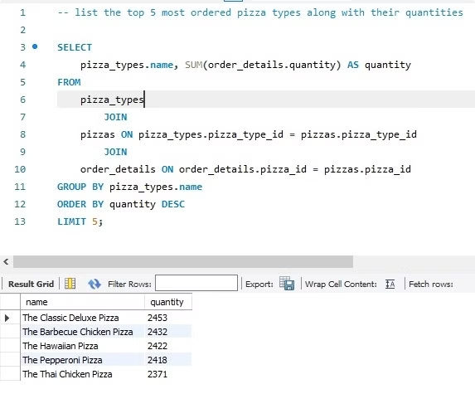
Pizza Sales Analysis
Top 5 most ordered pizza types with their quantities

Slide 7

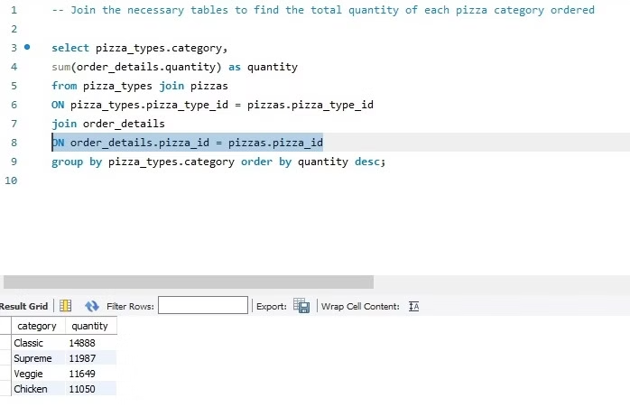
Pizza Sales Analysis
Total quantity of each pizza category ordered

Slide 8

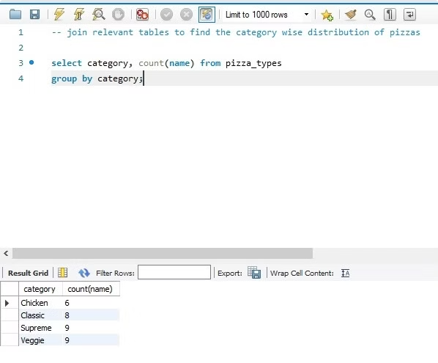
Pizza Sales Analysis
Category wise distribution of pizzas

Slide 9

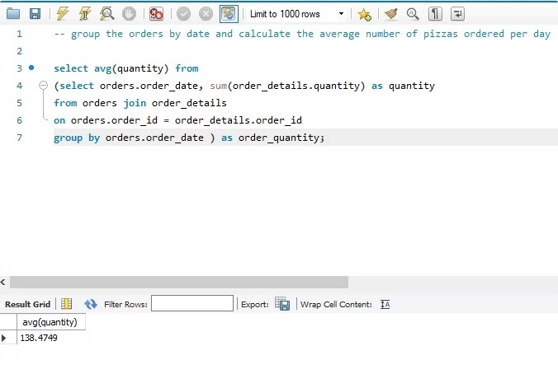
Pizza Sales Analysis
Average number of Pizzas ordered per day

Slide 10

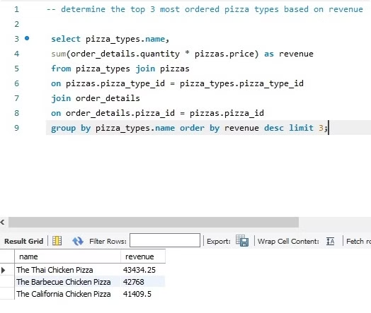
Pizza Sales Analysis
3 most ordered pizza types based on revenue

Slide 11

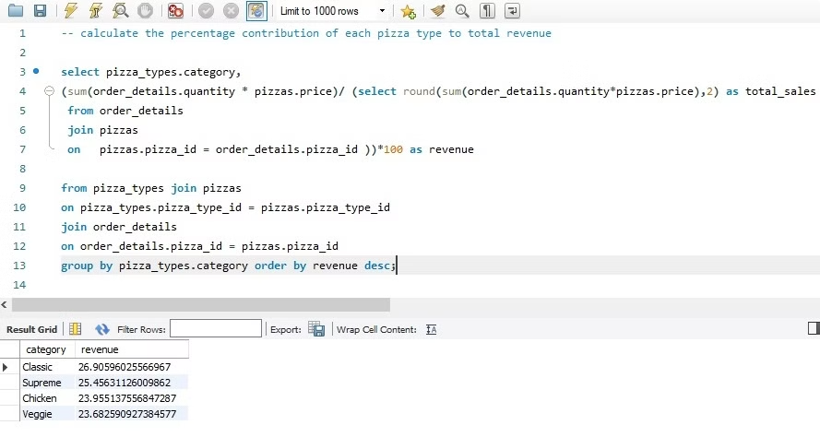
Pizza Sales Analysis
Percentage contribution of each pizza type to total revenue

Slide 12

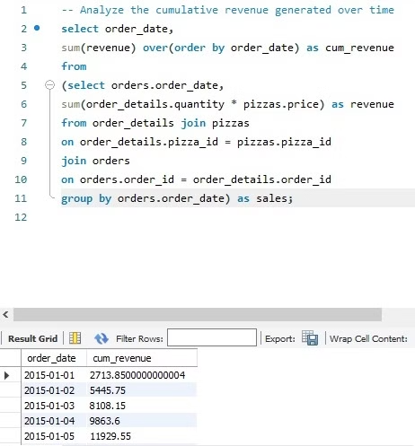
Pizza Sales Analysis
Cumulative revenue generated over time

Slide 13

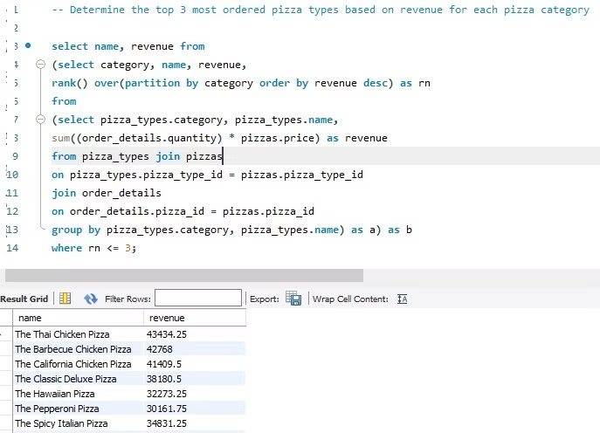
Pizza Sales Analysis
Top 3 most ordered pizza types based on revenue for each pizza category

Slide 14

Conclusion and Next Steps
This project provides valuable insights into pizza sales data, revealing customer preferences, sales trends, and areas for improvement. Future steps include incorporating real-time data, implementing inventory management strategies, and refining marketing campaigns for ongoing optimization.

